Slide 1
Looking Back to Stay Ahead: Recasting ACT as Behavior Analysis
Emily K. Sandoz, Ph.D., University of Louisiana at Lafayette

Slide 2
Relevant Financial Relationships
Private clinician, consultant, and trainer
Faculty and graduate coordinator at UL Lafayette
Author receiving royalties from New Harbinger publications
Relevant Nonfinancial Relationships
Associate Editor of JCBS
Co-Chair of CBA SIG, ACBS

Slide 3
Notes:
Welcome!
Sad about not being in New Orleans with you all AND this virtual conference is SO New Orleans.
A bit about NOLA-resilience
Let the good times roll.

Slide 4
Notes:
Process now popular,
Instead of empirically supported treatment packages defined by topography and linked to syndromes, we are watching increased interest in empirically supported mechanisms, linked to empirically supported procedures
Recent blog called ”future of psychology” - Process-based treatment allows therapists to identify mechanisms and how they present in your client, develop a formulation to explain how those mechanisms contribute to presenting problems, and select interventions that target these mechanisms throughout different stages of therapy.

Slide 5
Notes:
Good for clinicians – gives us something to watch for, a way to understand what we do in the room
Consistent with CBS Treatments - in ACT, FAP, clinical RFT, emphasis has long been on the scientific development and refinement of functionally defined mechanisms

Slide 6
Notes:
Why consistent? Functional contextualism!
Pepper, quite famously in our CBS heritage, described Contextualism as one of 4 worldviews, or approaches to speaking about the stuff that is the world we study, that vary along several dimensions:
the metaphor we apply to all the stuff we study (called root metaphor),
whether we hold parts or wholes as primary, and
how we evaluate our stories, how we know the analysis is complete (called truth criterion)

Slide 7
Notes:
Pepper’s Contextual perspective - no event (no thing) is defined, perceived, or understood outside of its context (to everything that’s on the other side of what we call it); its relation to its context IS what defines it, what characterizes it
Like a vase is defined by the empty space within it
Whole, the everything, the all, is primary in this perspective, and totally unknowable and unnameable from any of our perspectives
So every time we use language to peel out one event from the whole, we are abstracting
Examples – this computer, this headset, me, you, gravity, earth – all arbitrary distinctions with respect to the all
Even in saying “the whole, the all, the everything” I’m implying a nothing that is different from that
Every time we describe a thing as distinct from other things, we are abstracting
And even every time we describe relationships among things, we are abstracting
AND even every time we describe relationships among relationships, we are abstracting
Our terms, our stories, our theories -
And all this abstraction would be arbitrary except that right now, as we notice that behavior of abstracting, we notice it is also a part of the all, a behavior to be understood in terms of the context in which it is unfolding
And that is where the contextual approach to evaluating these stories, terms, and theories comes in

Slide 8
Notes:
Truth criterion:
Pepper proposes several: correspondence (do our stories describe and/or predict what we observe), coherence (do our stories fit with each other), and effective action (are our stories effective ways of interacting with what we observe with respect to our goals)

Slide 9
Notes:
And all viable scientific positions apply these criteria to some extent, but the dominant philosophical position in science tends to adopt correspondence
Science is described as dis-covery
Theories, terms, stories evaluated like you might a mirror
It’s not that science doesn’t care about being applicable for effective action- the assumption is that if the mirror is accurate, effective action will follow
There’s a lot inside this assumption, though – assuming there are real parts, real distinctions to be discovered, real relationships between those parts, and that Knowing those Parts, and the real relations amongst them is the start of Doing good work

Slide 10
Notes:
And this doesn’t work from a contextual perspective
From this perspective, there aren’t real parts, or real relations among those parts to be dis-covered,
So our words are always admittedly falling short of naming the whole, because they are always abstracting
From this perspective, every event is equally defined by everything it isn’t AND everything it is; its relational properties are as important for knowing how to name it (or more, at times) than its absolute properties
The story about the world would have to be as complex as the actual world to correspond and cohere perfectly

Slide 11
Notes:
So, while we don’t abandon coherence or correspondence entirely (we couldn’t), we emphasize effective action
We approach every term, every theory, every story about the world with a sense of the job they should do
Instead of evaluating our stories as mirrors, we evaluate them as hammers
Does this term, this theory, this story do the job?
Is this abstraction that I’m making working
Instead of assuming that Knowing fosters Doing, we assume that the Knowing is in the Doing, that we Do in order to know
And – this is a tough perspective

Slide 12
Notes:
It’s tough because (as a lovely colleague insisted recently) we’ve got a loooong learning history of selecting our words, our stories, our ideas, by how they match our observations and how they fit with each other
It’s tough because (as a lovely colleague insisted recently) we’ve got a loooong cultural history of selecting our words, our stories, our ideas, by how they match our observations and how they fit with each other
It’s tough because (as the same lovely colleague insisted recently) we’ve got a loooong evolutionary history that supports selecting our words, our stories, our ideas, by how they match our observations and how they fit with each other
In other words, it’s tough because in most spaces, for most jobs we’ve got to do, correspondence and coherence are good enough, and have been good enough for generations upon generations.
So fundamentally changing the way we see and interact with our stories about the world is not ever going to be easy
Enter middle level terms.

Slide 13
Notes:
We are fortunate enough to have had some incredible people leading the development of this particular corner of behavioral science, folks who not only positioned contextualism at the center of the conversation, but who took seriously the challenge to write stories about the world that accomplished their aims
The developers of ACT and founders of CBS, like all folks responsible for huge shifts in psychological treatment, found themselves doing something really special and impactful in the therapy room that was worth sharing.
For a long while, they used the words that got them there, basic terms in behavior analysis that were tried and true in many ways – they corresponded with emerging basic data, and were allowing for analysis of clinically-relevant events in new and exciting ways
And these terms had also proven difficult for non-BAs to grapple with, so the challenge was to develop a way of speaking about how to do thereapy that continued to correspond to the observed findings, and cohere with the stories we told about those findings, and that went one step further – that provided the necessary context for research and clinical work in this new field of CBS

Slide 14
Notes:
Eventually they landed on what have been called middle level terms (terms situated between common, nonscientific ways of speaking for common, nonscientific purposes) in the BA world, and what are more commonly called the 6 component processes of ACT: the psychological flexibility model, or the hexaflex.
And in many ways, these terms worked.
Broad dissemination 8000 people in ACBS across a number of countries, over 250 (check) RCTs on ACT, recognition of ACT as an EST in a number of systems
But do the mid-level terms work in the room?
Does training clinicians using the flexibility model make them good at observing for and intervening on flexibility?
Is it the best we can do?

Slide 15
Notes:
I fear that the answer is no.
Problems with midlevel terms = by necessarily collapsing distinctions we see in the basic scientific findings on which they are based, they often pull for personological accounts
Problem with personological accounts = lack sensitivity, responsiveness, and creativity with process
They pull for us to play the correspondence game

Slide 16
Notes:
Putting together Ikea furniture

Slide 17
Notes:
Correspondence game

Slide 18
Notes:
pottery

Slide 19
Notes:
Function game

Slide 20
Notes:
What if there was a whole approach to Beh sci that was about playing the function game? Enter BA/CBS

Slide 21
Notes:
What do I mean by behavior? Everything an organism does.
We abstract some behavior we are interested in from an INFINITE number of behaviors
One term that I love is the behavioral stream – it’s constantly changing, flowing through time like water, currents flowing…
Take a moment to reflect on this. Imagine a person’s dynamic behavioral stream, constantly changing at multiple levels
The behaviors we can see, the ones we intuit from what we can see
Notice - All the choices we have in selecting what behavior we will abstract out.
How we abstract that behavior out by naming it. (Note that we can evaluate the best term to describe the behavior in terms of how workable it is in allowing for a complete analysis)
Once we’ve got the behavior, we abstract some context that seems to impact that behavior from an INFINITE number of things outside the behavior
Context could be anything outside of the behavioral stream, before or after, that impacts (1) the behaviors we observe, and (2) the relationships amongst those behaviors
So much could matter, we could end up trying to account for everything
But our philosophy saves us – we focus on what works to change lives
We concern ourselves primarily with contexts we can directly manipulate
And once we’ve got a behavior we want to understand and change, and some manipulable contexts we are guessing might matter, we play our function game – we change the context to change the behavior
In this way, we establish function – the relationships between context and behavior
The function of a context or stimulus = the behavior that occurs in its presence
The function of a behavior or response = the conditions under which that behavior occurs

Slide 22
Notes:
Implications for therapy = the analysis includes us! We ARE the context for the observations we are making
we’re watching the client behave in this long, dynamic stream, watching their behavior change as the context changes, watching their learning history unfold in the moment, and changing context to create a new learning history – one that is more workable
This is clinical behavior analysis
Understanding the therapeutic process in terms of context (our interventions), behavior (client’s behavior in the room), and function (how we are impacting the client, how their behavior makes perfect sense based on what we are doing)
Implications = behavior observable, function observable, context observable
Job = make pottery

Slide 23
Notes:
Function could be overwhelming – if function is just the relationship between context and behavior,
there are as many potential functions of a context as there are behavior, as many different potential functions of a behavior as there are events occurring

Slide 24
Notes:
Contexts that matter can be split into 2 kinds of functions:
Aversive contexts → narrowing of context + running, fighting, hiding + the private behaviors that go with that
Appetitive contexts → broadening of context + seeking, engaging, enjoying + the private behaviors that go with that
What Skinner meant by Freedom

Slide 25
Notes:
Aversive control – running fighting or hiding
Not just negative reinforcement

Slide 26
Notes:
It comes to dominate, not only that moment, but other moments, as we make up rules about
how things must be (us, the world, other people),
how things must have been (us, the world, other people),
how things must be in the future (us, the world, other people),
You can imagine this one current in the behavioral stream, that brings new rules to bear each time the world changes
And we get better and better at running, fighting, and hiding, and better and better at making rules that help with that

Slide 27
Notes:
Appetitive control
Seeking, exploring engaging
Not just positive reinforcement

Slide 28
Notes:
Implications for therapy = watching whole repertoire in context, watching transitions
Creating contexts that evoke bx under aversive control and add to the context in such a way as to build the repertoire
Reinforcing – 3 ways

Slide 29
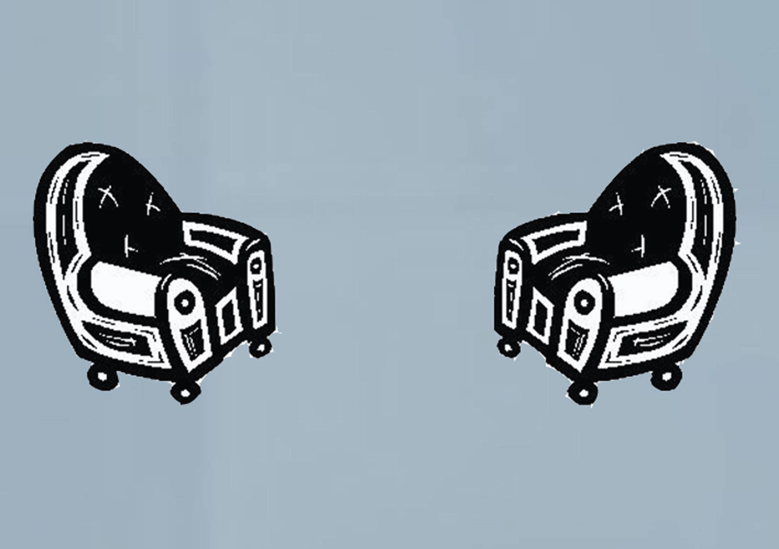
Notes:
build out all the ways we know folks can thrive

Slide 30
Notes:
Psychological flexibility model

Slide 31
Shifting attention among:
Thoughts
Feelings
Perceptions
Notes:
Psychological flexibility model

Slide 33
Responding to Aversives with:
Awareness
Approach

Slide 35
Shifting among experiences of:
Self
Other

Slide 37
Shifting perspective across:
Person
Situation
Time

Slide 39
Tracking:
Behavior
Context
Function

Slide 41
Responding to Appetitives with:
Awareness
Approach

Slide 42
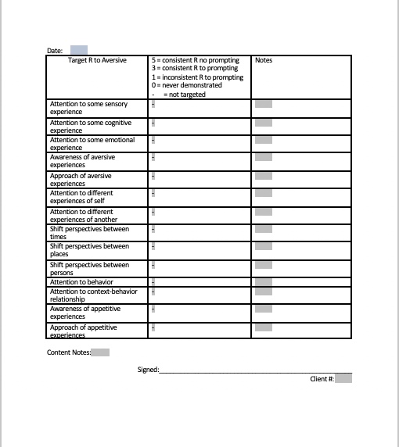
Notes:
Next steps?
Practice
Flexnotes
Come up with your own!

Slide 43
Looking Back to Stay Ahead: Recasting ACT as Behavior Analysis
emily.sandoz@louisiana.edu

